Slide 1

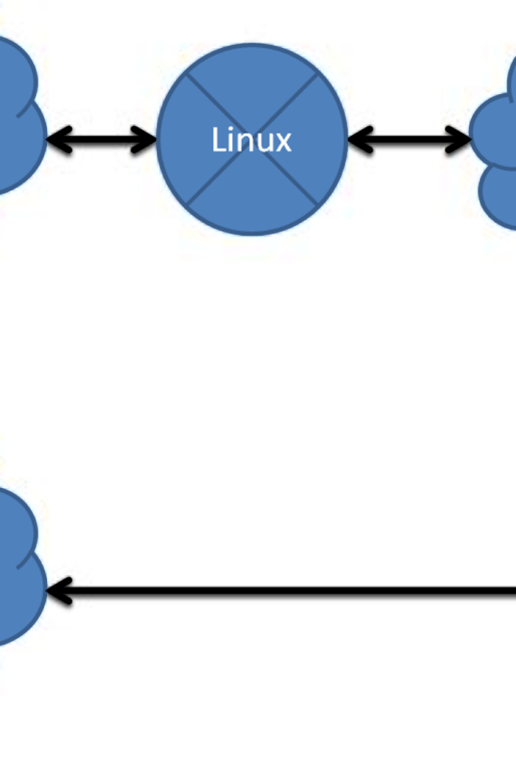

Use and Installation of Proxy Server

Slide 2
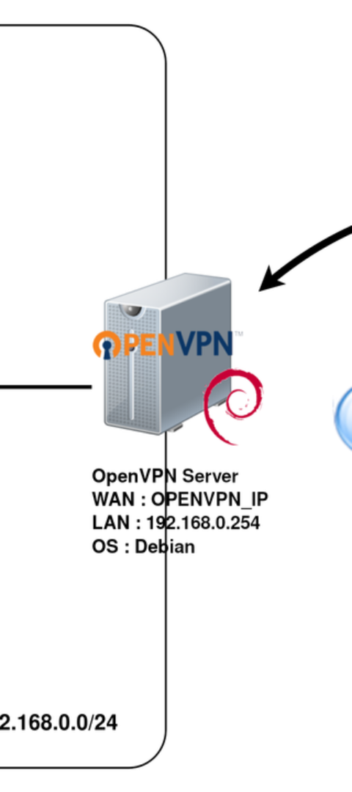
Introduction to Proxy Servers
1
Definition of Proxy Servers
A proxy server acts as an intermediary between users and the internet, processing requests and responses to provide functionalities such as security, caching, and anonymization.
2
Purpose and Benefits
Proxy servers serve multiple purposes, including improving performance through caching, enhancing security via web content filtering, and providing anonymity by masking IP addresses.
3
Relevance in Network Operations
Proxy servers play a crucial role in optimizing traffic flow, protecting against threats, and enabling access control in modern network management.

Slide 3
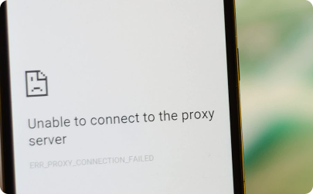
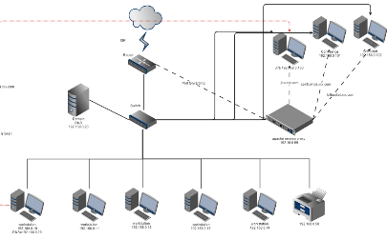

Types of Proxy Servers
Forward Proxy
Reverse Proxy
Transparent Proxy
Distinguishing characteristics and situational uses of forward proxy servers in network environments.
Exploring the practical applications and benefits of deploying reverse proxy servers for load balancing and security.
Understanding the functionality and relevance of transparent proxy servers in network traffic management and filtering.

Slide 4

Proxy Server Installation Overview
1
Importance of Proper Installation
2
Key Steps in Installation Process
Proper installation ensures optimal functionality, performance, and security of the proxy server within the network environment.
The installation process involves system requirements assessment, software selection, configuration, and testing to ensure seamless integration.
3
Common Proxy Server Software
Notable proxy server software includes Squid, known for its robust caching abilities, and Nginx, favored for its flexibility and performance.

Slide 5
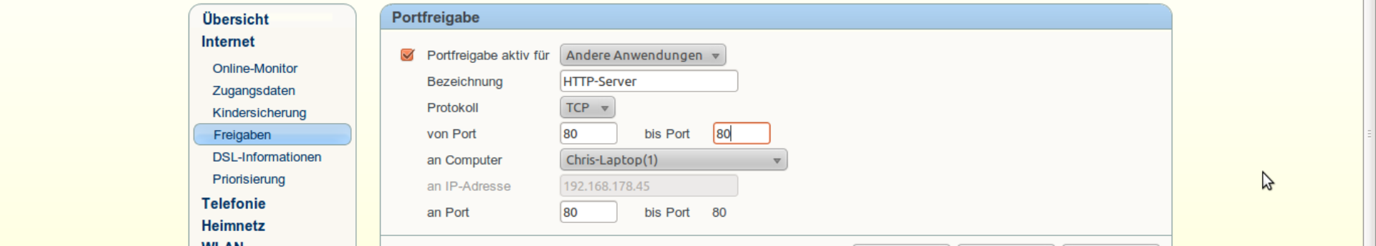



Step-by-Step Installation Guide
Step 1
Step 2
Step 3
Evaluate system requirements and select appropriate hardware and software for the proxy server.
Install the chosen proxy server software and configure basic settings such as port numbers and access control lists.
Perform thorough testing of the installation by simulating various network scenarios to ensure stability and security.

Slide 6
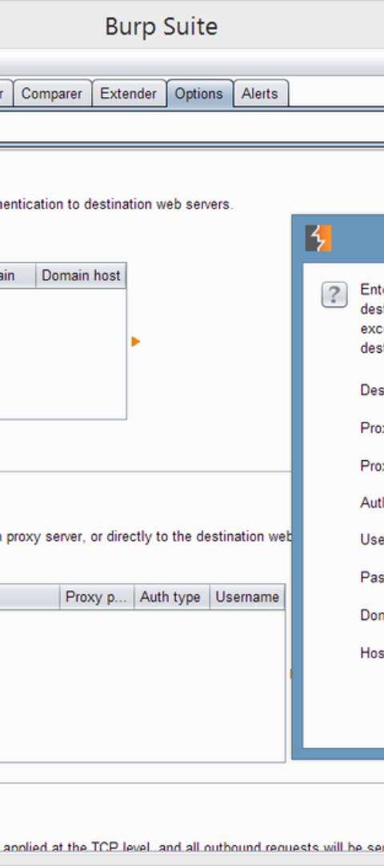
Configuration and Settings
Explanation of Configuration Options
Importance of Proper Settings
Proper settings ensure that the proxy server operates efficiently, effectively manages traffic, and secures network communications.
Configuration encompasses setting up access control, defining caching policies, and enabling security features to align with organizational requirements.
Demonstration of Configuring
A step-by-step demonstration of configuring a simple proxy server setup using popular software will be presented.

Slide 7
Proxy Server Use Cases
1
2
Bypassing Geographical Restrictions
3
Examples of Beneficial Situations
Highlighting Industries or Sectors
Proxy servers find extensive usage in corporate environments, educational institutions, and public Wi-Fi networks, providing enhanced security and performance.
Many online services restrict access based on users' geographical locations. Proxy servers located in different regions can allow users to bypass these restrictions and access content that may be unavailable in their country.
Specific industries, such as finance and healthcare, their benefits will be significantly emphasized by proxy servers

Slide 8
Load Balancing
5
Protecting Personal Information:
4
In large-scale web applications or networks, proxy servers can distribute incoming traffic across multiple servers to ensure optimal performance and prevent overloading of individual servers.
Proxy servers can hide your IP address and encrypt your important data, protecting your online privacy.

Slide 9

Security Considerations
1
Role of Proxy Servers in Enhancing Security
Proxy servers enhance security by filtering malicious content, preventing direct access to internal resources, and masking the identity of internal users.
2
Potential Security Risks
Despite their advantages, proxy servers can introduce risks such as data breaches, privacy concerns, and performance degradation if improperly configured.
3
Best Practices for Securing Installations
Best practices, including regular updates, monitoring, and strict access control, are essential for securing proxy server installations.

Slide 10
Advantages and Disadvantages
Benefits of Using Proxy Servers
Drawbacks or Challenges
Considerations for Decision Making
Enhanced security, improved performance, and privacy protection are among the key benefits of using proxy servers in network operations.
Latency issues, configuration complexity, and potential single points of failure are notable challenges associated with the use of proxy servers.
Comprehensive risk-benefit analysis and alignment with organizational goals are critical when considering the adoption of proxy servers.

Slide 11

Future Trends and Developments
1
Emerging Technologies in Proxy Servers
2
Evolving Use Cases
3
Potential Future Developments
New use cases are emerging, including edge computing, hybrid cloud security, and decentralized network architectures, transforming the role of proxy servers.
Developments in quantum-resistant encryption, blockchain integration, and zero-trust security models are poised to impact the future evolution of proxy server technologies.
Technological advancements, such as AI-driven proxy management and IoT integration, are shaping the future of proxy server technologies.

Slide 12
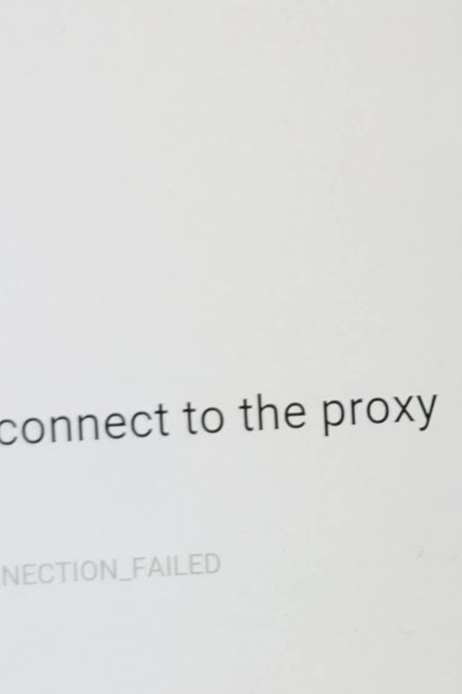
Conclusion
In conclusion, understanding the types, benefits, installation process, configuration, troubleshooting, and best practices for using a proxy server is essential for optimizing security, privacy, and internet accessibility. Implementing and managing a proxy server effectively can significantly enhance the online experience.

